Slide 1

Introduction to neural networks

Slide 2
Definition of ANN
“Data processing system consisting of a large number of simple, highly interconnected processing elements (artificial neurons) in an architecture inspired by the structure of the cerebral cortex of the brain”

Slide 3
Points to note
Artificial Neural Networks are normally called Neural Networks (NN).
Neural Networks is the essence of Deep Learning.
Neural network: information processing paradigm inspired by biological nervous systems, such as our brain.
Structure: large number of highly interconnected processing elements (neurons) working together .
Like people, they learn from experience (by example)

Slide 4
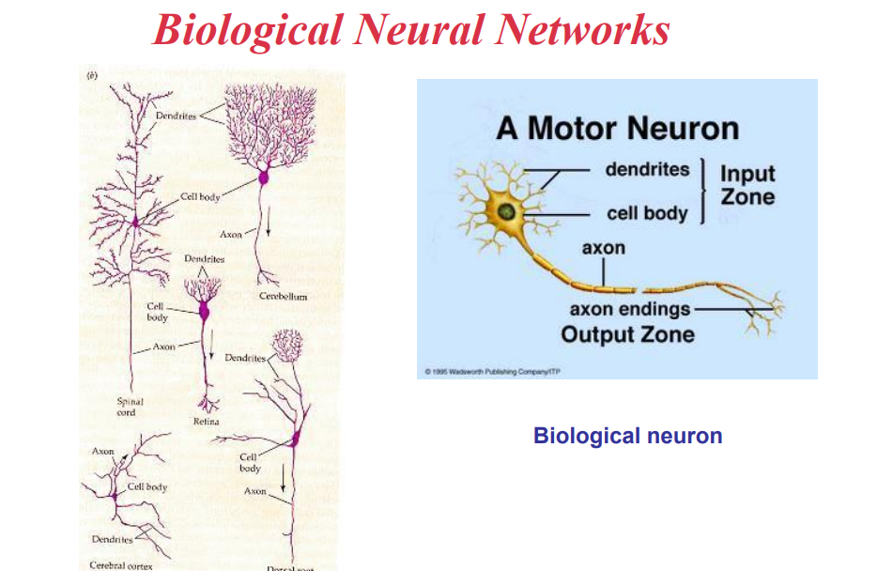

Slide 5
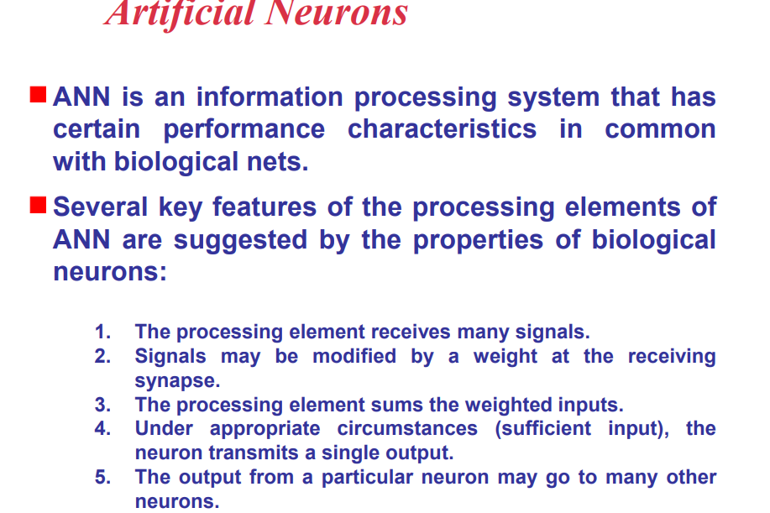

Slide 6
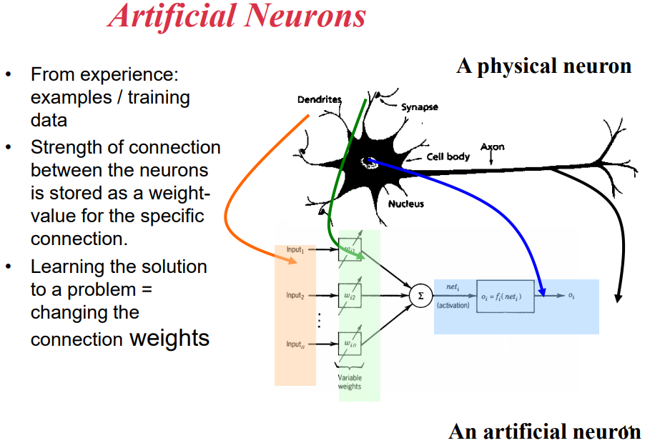

Slide 7
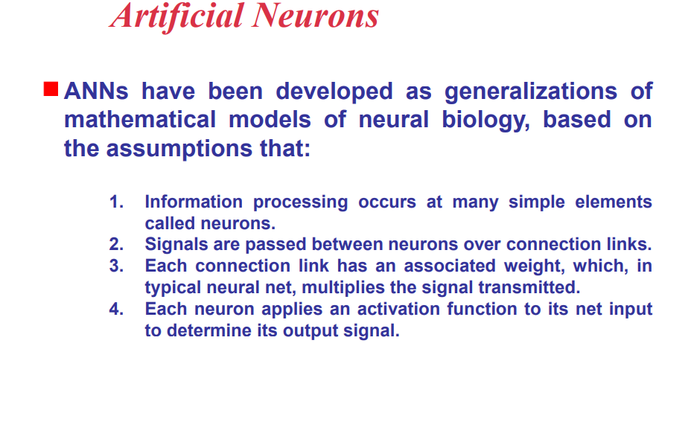

Slide 8
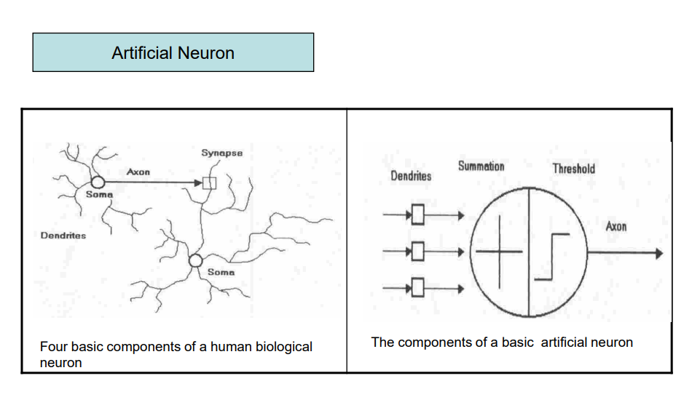

Slide 9
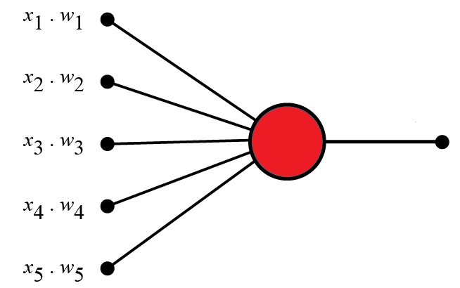
Perceptron
A Perceptron is an Artificial Neuron
It is the simplest possible Neural Network
The original Perceptron was designed to take a number of binary inputs, and produce one binary output (0 or 1).
The idea was to use different weights to represent the importance of each input, and that the sum of the values should be greater than a threshold value before making a decision like true or false (0 or 1).

Slide 10
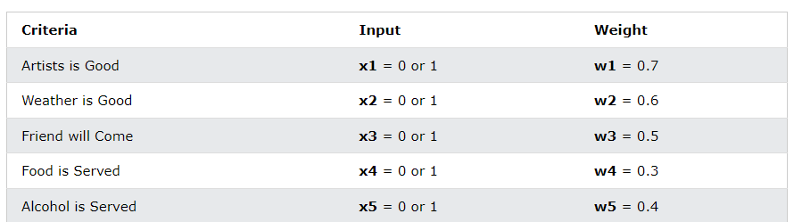
Perceptron Example
Imagine a perceptron (in your brain).
The perceptron tries to decide if you should go to a concert.
Is the artist good? Is the weather good?
What weights should these facts have?

Slide 11
The Perceptron Algorithm
Frank Rosenblatt invented a Perceptron program.
Frank Rosenblatt suggested this algorithm:
Set a threshold value
Multiply all inputs with its weights
Sum all the results
Activate the output

Slide 12
1. Set a threshold value:
Threshold = 1.5
2. Multiply all inputs with its weights:
x1 * w1 = 1 * 0.7 = 0.7
x2 * w2 = 0 * 0.6 = 0
x3 * w3 = 1 * 0.5 = 0.5
x4 * w4 = 0 * 0.3 = 0
x5 * w5 = 1 * 0.4 = 0.4
3. Sum all the results:
0.7 + 0 + 0.5 + 0 + 0.4 = 1.6 (The Weighted Sum)
4. Activate the Output:
Return true if the sum > 1.5 ("Yes I will go to the Concert")

Slide 13
Perceptron Terminology
perceptron Inputs
Node values
Node Weights
Activation Function

Slide 14
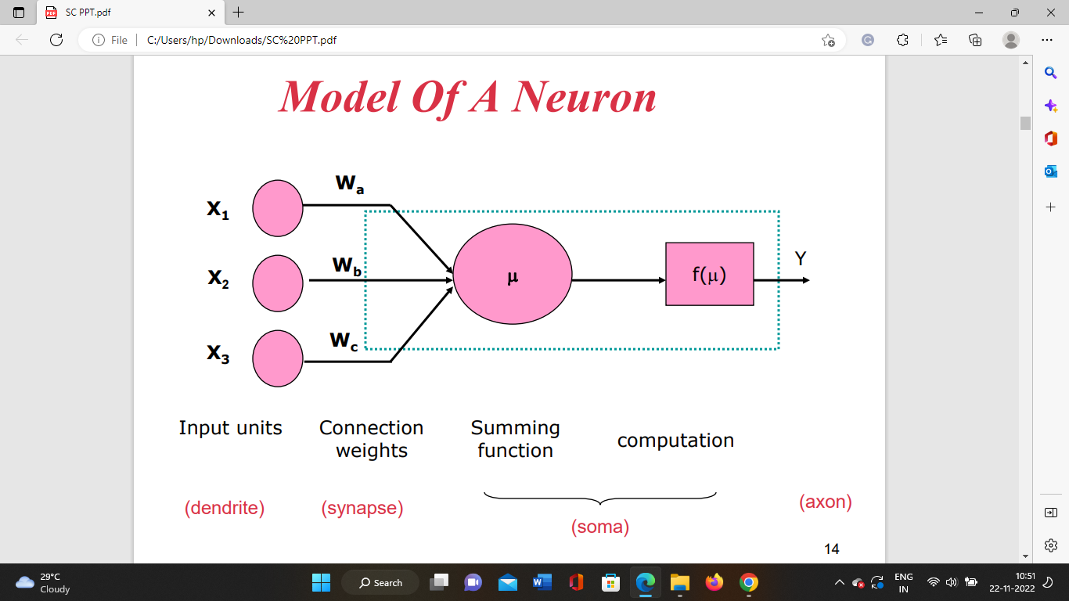

Slide 15
Perceptron Inputs
Perceptron inputs are called nodes.
The nodes have both a value and a weight.
Node Values
In the example above, the node values are: 1, 0, 1, 0, 1
The binary input values (0 or 1) can be interpreted as (no or yes) or (false or true).
Node Weights
Weights shows the strength of each node.
In the example above, the node weights are: 0.7, 0.6, 0.5, 0.3, 0.4
The Activation Function
The activation functions maps the result (the weighted sum) into a required value like 0 or 1.
In the example above, the activation function is simple: (sum > 1.5)
The binary output (1 or 0) can be interpreted as (yes or no) or (true or false).

Slide 16
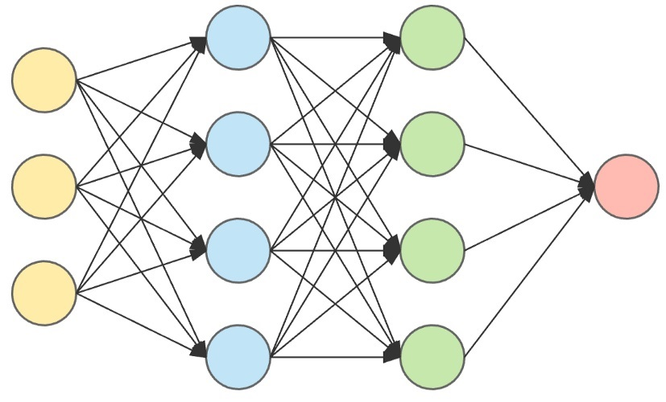
The Perceptron defines the first step into Neural Networks.
Multi-Layer Perceptrons can be used for very sophisticated decision making.

Slide 17
In the Neural Network Model, input data (yellow) are processed against a hidden layer (blue) and modified against more hidden layers (green) to produce the final output (red).
The First Layer: The 3 yellow perceptrons are making 3 simple decisions based on the input evidence. Each single decision is sent to the 4 perceptrons in the next layer.
The Second Layer: The blue perceptrons are making decisions by weighing the results from the first layer. This layer make more complex decisions at a more abstract level than the first layer.
The Third Layer: Even more complex decisions are made by the green perceptons.

Slide 18


Slide 19
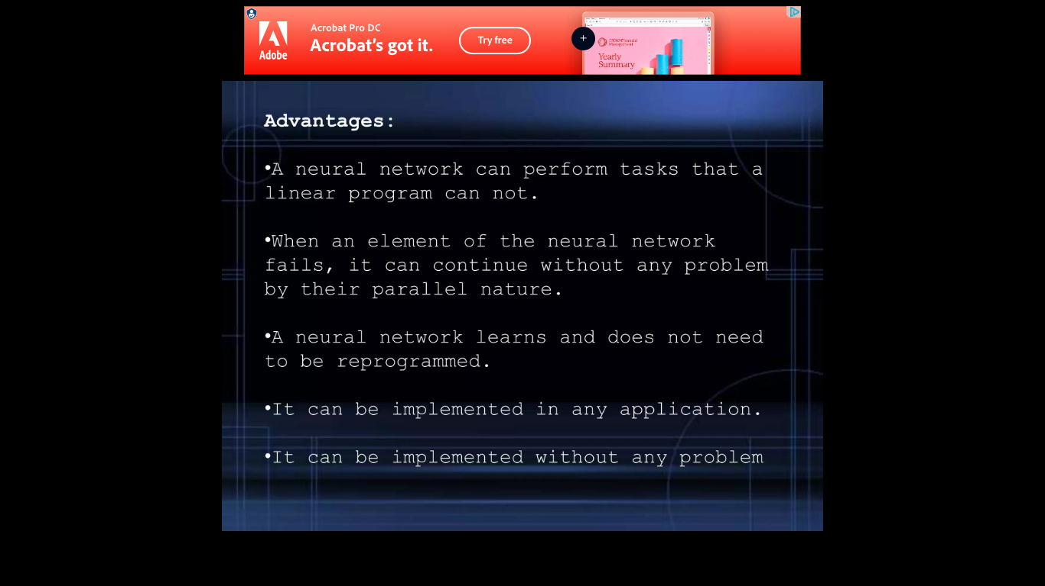

Slide 20
